Slide 1
New Media and Copycat Crime
Kimberly Kampe, M.S., M.A.
University of Central Florida

Slide 2
The Nature of Copycat Crime
Copycat Behavior
Negative modeling may appear in the form of copycat crime
Crime Generator Media Content and Attention Copycat Crime and Criminal
Aggregate v. Individual Models
Notes:
Copycat Behavior…First coined by Sarah Jewett (1896), the term copycat has become a common part of our modern culture. Referring to the fact that people copy the models of behavior that they see exhibited by those around them, this modeling process has been conceptualized to occur through any of a number of different biological, psychological, and social processes.
Negative modeling may appear in the form of copycat crime…Behavior that is modeled may not always conform to the norms, values, and culture of the society in which they are exhibited. This negative form of the modeling process may be seen in behaviors such as copycat crime.
Copycat crime is considered both an individual and social level phenomena. A copycat criminal, an individual that chooses to commit a crime as a result of the information and models received from the media, is then exposed to this prior media-publicized or portrayed generator crime. This exposure leads to the incorporation of elements of the generator crime, such as the crime’s motivation, victim, or technique, into the later copycat crime. Copycat crimes differ in their content, complexity, form, and duration. In addition, the type and amount of media exposure to criminogenic content (media content that encourages crime) as well as different copycat criminal characteristics will also impact participation in copycat crime.
Aggregate v. Individual Models…Copycat criminals are expected to differ on a number of characteristics including their demographics, perceptions, social environment, criminal histories, and exposure and interaction with the media. It has been hypothesized that those who are predisposed to criminal behavior, being a prior offender further increases the impacts, are more likely influenced by criminogenic content, and thus more likely to commit a copycat crime. In addition to the variation that exists among copycat criminal characteristics, there are also variations in the level of copycat crimes committed based on geographic locations, societal cultures and norms, and time period. This leads to two different models of copycat crime: the aggregate model and the individual model.
Aggregate Model…Examines why societies differ in their levels of crime, types of crime, and how crime is displayed. The aggregate model breaks down the copycat crime process into two phases. In Phase A, crimes do not necessarily come to the media’s attention, or need to come to the media’s attention, to lead to copycats due to the larger preexisting pool of potential offenders. For example, Phase A would include a great deal of property crime. In Phase B, a secondary “at-risk” pool of potential copycat criminals is introduced and second-order copycat crimes are possible. In Phase B, generator crimes are picked up by the media, and, they are usually violent events. It is these crimes that the media places the most emphasis on, even though they are the rarest crimes, and it is this criminogenic media content that causes most people to fear violent copycat crime.
Individual Model…The second model, the individual model, looks at the processes by which someone becomes a copycat criminal. The first path is systematic central processing, and is the least used process. Usually leading to instrumental copycat crimes, such as property crimes, systematic central processing is largely dependent on motivation and planning as it is about decisions that the individual feels are important. However, the decision maker must have access to information that helps them to make their choice; this is where the media may provide techniques or instructions. The second path is heuristic peripheral processing, and is a more frequently used process. Usually leading to emotive copycat crimes, such as violent fights, heuristic peripheral processing usually involves emotional, spontaneous, and opportunistic decisions to be made. The third and final path is narrative persuasion, and it is the most used process. Usually leading to empathy or identification through transportation and engagement (the media’s ability to provide escapism from reality into the world of the narrative), in narrative persuasion, people interact with the media with the intent of using the information they obtain to make decisions. Narrative persuasion highlights the media’s ability to transform attitudes and opinions, such as the belief that copycat crime is a good idea, and thus, to influence the behaviors of those exposed to the media’s content, such as potential copycat criminals. These three paths all lead to the psychological states of priming and script activation, which then leads to copycat crime performance. In the individual model, many learn how to commit a crime from the media. However, most do not copy the models that they see; implementation of media models is the key.

Slide 3
Copycat Crime Dimensions
Time and Motive
Genesis v. Metamorphic
Type of Crime
Full v. Partial
High Profile v. Low Profile
Simple v. Complex
Loner v. Groups
Stand Alone v. End Life Crimes
Medium Exposure
Notes:
Time and Motive… There are two dimensions that lead to four main types of copycat crime based on time and motive. In crimes that are considered emotive and instantaneous, there is very little planning and evaluation that takes place prior to copying behavior. In contrast, thought and consideration goes into copying behaviors when the crimes are more instrumental and delayed.
Genesis v. Metamorphic…Looking at whether the media acts as a trigger (genesis-media attention leads to crimes that otherwise may not have occurred) or a rudder (metamorphic-crime is molded by media attention), this dimension looks at the role of the media in copycat crime. If a crime is a genesis crime, it would not occur without the media’s influence. On the other hand, metamorphic copycat crimes occur in different forms due to the influence of the media, but the crime would have occurred regardless of the media exposure. These crime types tend to overlap and interact with the type of media exposure and are related to the cognitive processes that are utilized.
Type of Crime…This dimension may compare property versus violent crime, planned versus impulsive crime, or rational versus irrational crime.
Full v. Partial…Whether a copycat crime is full, exact mimics, or partial, borrowed pieces of behavior. In a full copycat crime, every element of the crime is modeled from media coverage. However, partial copycat crimes are more likely because people are rational beings. With partial copycat crimes, there may not be a generator crime. Instead, the copycat criminal takes parts from many different crimes and uses them as a composite for their crime.
High Profile v. Low Profile… High profile, with the goal of publicity, or low profile, with the goal of reducing risk. The motivations of copycat criminals will vary depending on whether the copycat criminal wants media exposure, as is the case with high profile copycat crimes, or whether they seek to copy the crime because they feel as though it will reduce their chances of failure, apprehension, and punishment, as is the case with low profile crimes.
Simple v. Complex…Simple copycat crimes are more likely to be copied due to the ease of learning the crime modeled. More complex copycat crimes are less common but tend to be covered more by the media.
Loner v. Groups…Yet another dimension is whether the copycat criminal is a loner or prefers to commit their copycat crimes in groups. There is an expectation that the preferences of the copycat criminal to act alone, as part of a collective behavior, as part of a team, or part of a gang or mob is going to depend partially on the characteristics of the copycat offender as well as on the characteristics of the collective.
Stand Alone v. End Life Crimes…Another consideration is whether the copycat crime was a stand-alone event, which relies on individual level of analysis, or part of a life cycle, which relies on the examination of aggregate waves and diffusion patterns. Stand-alone copycat crimes are isolated events in which one copycat criminal copies. However, when there are multiple copycat crimes with one following another, a pattern is developed. The first part of this pattern is the campaign (events that take place over months in one location) followed by a wave (a series of campaigns over the course of months that take place in different locations), followed by cycles (combinations of waves and the addition of new behaviors that diffuse from media centers to rural areas of a society), and finally concluding with the copycat end life (electronic gatherings).
Medium Exposure…Finally, there is an interaction between the type of medium exposure and the copycat crime, with visual media models being the most likely to be copied.

Slide 4
Copycat Crime Hypotheses
Copycat crime is though the result from the interaction of four main areas
Generator crime and the criminal model
Subsequent media coverage
Social context
Characteristics of potential copycat criminals
Criminogenic media content will concentrate its influence in preexisting criminal populations
The effect of the media tends to be more qualitative than quantitative
Copycat criminals are more likely to be career criminals who are involved in property crimes rather than first-time offenders or offenders that are committing violent crimes
Notes:
Copycat crime is though the result from the interaction of four main areas:
Generator crime and the criminal…usually those that are successful and engaging are shown by the media and become prime candidates for copying.
Subsequent media coverage…The media coverage of the crime first impacts individuals by allowing them the opportunity to identify with the generator crime and the criminal model.
Social context…This provides a pool of potential copycat criminals with the size of the pool being influenced by the amount of media exposure, social factors, the existence of social conflicts, the number of opportunities available for copycat crime, the nature of the media, and the size of the preexisting criminal population. For example, the United States can expect to have a high rate of copycat crime based on the high level of criminogenic media, the amount of media that is given from the offender’s point of view, the large preexisting offender population, the setting, and a culture that is rooted in a violent history.
Characteristics of potential copycat criminals…Copycat offenders are often seen as having an emersion in criminogenic media. They tend to focus on a single media source, which they use for information or learning. Copycat offenders do not see law-abiding behavior as rewarding, and often identify with media offenders. They see media personalities as leaders and friends to the exclusion of interpersonal contacts. Copycat offenders are also weakly networked into law-abiding groups while being strongly networked into deviant groups. They place a decreased value on peers and family and generally have weak social bonds. Copycat offenders are also criminally innovative, disinhibited, and often delusional. They have a high interest in law enforcement and guns, but have resentments toward persecution. Their intelligence is mixed (those who are of high intelligent are able to receive information but have lower persuasive yielding while those of lower intelligence are less able to receive information but have higher persuasive yielding), and they seek assistance on easy tasks. Copycat offenders enjoy seeing laws broken and authority defied. They have a history of reward for imitation, but their criminal history shows an inconsistent pattern in the punishment of deviancy. The setting of copycat offenders, their family, neighborhood, and cultural influences, also play a factor. Copycat offenders tend to have a pervasive culture of crime, and enjoy crime saturated media. They have supportive social conditions that increase the permissibility of crime and the functional value of crime. Crime is seen as being rewarding, justified, and is usually unchallenged by those surrounding copycat offenders. They may also have criminogenic parents that provide real life models for the copycat offender. Finally, the offender may be experiencing racial strife, income disparity, and other detrimental social conditions.
Criminogenic media content will concentrate its influence in preexisting criminal populations…This has been supported by research that has found that as much as 25 percent of offenders engage in copycat crime according to self-reports. This hypothesis is further supported by research that has found that this rate is much lower in non-incarcerated populations.
The effect of the media tends to be more qualitative than quantitative…Media content tends to impact criminal behavior rather than the number of criminals. Most of the research that supports this hypothesis shows that preexisting offenders tend to use the media as a way to borrow crime techniques. This gives foundation to the claim that the media tends to act as a rudder more often than as a trigger for copycat crime.
Copycat criminals are more likely to be career criminals who are involved in property crimes…This is supported by the research that finds that offenders report using the media as a way to learn techniques for committing crime, usually property crimes, rather than as a motivation to commit a violent crime.

Slide 5
The Nature of New Media
Media that has emerged in the latter part of the 20th century
The Internet
Websites
Computer Multimedia
Video Games
CD ROMS
DVDs
Social Media Models
Most new media technologies are digital
Have the characteristics of being manipulated, networkable, dense, compressible, and interactive
Provides:
On-demand access to content at any time, from any location, on any digital device
Interactive user feedback, creative participation, and formation of communities around media content
Real-time generation of new, unregulated content
Holds the promise of the democratization of the creation, publishing, distribution, and consumption of media content

Slide 6
New Media Impacts
Societal Changes
Shift from modernity to postmodernity
Intensification of globalization
Shift from Industrial Age to Information Age (in the West)
Decentralization
Individual Changes
Textual experience
New ways for users to represent the world
Relationships between users and their technology
Ways users received images and messages and the meanings involved
How users define themselves and the community
Behavior
SystemChanges
Economic
Political
Idea exchange
Notes:
Societal Changes…
Shift from modernity to postmodernity…Usually this shift is described in terms of the sweeping social and cultural changes that transpired after the 1960s. Often considered the result of changing structural and economic social systems, the changes that new media is having on modern society may also be seen as furthering this shift into postmodernism.
Intensification of globalization…There is no longer the national boundaries that previously existed on trade, corporate organization, customs, cultures, identities, beliefs, and norms that previously existed. New media has been seen to be a major contributing factor in this process
Shift from Industrial Age to Information Age (in the West)…This has required a shift in employment, skill, investment, and profit in the production of goods and the provision of services.
Decentralization…in the previously centralized geo-political centers. The mechanisms and powers of the Western colonial centers have been weakened and exert less power as the national boundaries of traditional media have been overstepped by new media channels.
Individual Changes…
Textual experience…New media has led to new genres, textual forms, forms of entertainment and pleasure, and ways of consuming media.
New ways for users to represent the world…While these ways are not always be clearly defined, new media offers the opportunity for changes in experience and representation to occur.

Slide 7
Theoretical Discussion
Suggesto-imitative crime
Collective behaviors
Fads and Fashions
Diffusion
Imitation
Scripts and Priming
Social Learning
Notes:
Suggesto-imitative crime…Gabriel Tarde was the first to connect the process of imitation with that of copycat crime in the late nineteenth and early twentieth century. He observed that violent crimes that were sensational in nature seemed to produce similar incidents. He described copycat crime by stating that, “Epidemics of crime follow the line of the telegraph,” meaning that crimes seemed to spread through societies in waves in a downward (from upper classes to lower classes) and outward (from urban cities to rural areas) fashion. While Tarde did believe that crime was imitated, just as law abiding behavior, he also felt that because crime was fundamentally different from law abiding behavior, the imitation process for criminal behavior would also differ from the imitation of law abiding behavior. Tarde also believed that some of the differences between criminals and non-criminals were based on psychological predispositions, individual choice, social conditions, and sometimes even chance circumstances all played a role in whether or not someone becomes involved in criminal activities.
Collective behaviors…Charles Mackay and Gustave LeBon. However, it was the 1920s before collective behavior became a term that was studies in the literature. The idea of collective behavior was that people act differently when they part of a crowd. This behavior may be positive or negative depending on the context of the situation.
Fads and Fashions…Fads are the less predictable of the two types of behavior. They also have shorter life cycles that tend to be more intense than that of fashions. In addition, they are often more trivial. Fashions are longer term trends that allow social segregation and elitism. The media plays a central role in these processes as the collective community that is formed by those engaged with the media serve to transform individual ideas and innate behaviors
Diffusion…Diffusion was one of the ways that fads, fashions, and copycats could be seen as moving through a society. An aggregate social group process of imitation, diffusion has mostly been studied with a focus on prosocial positive behaviors. In looking at which individuals adopt innovations and why, it is believed that there are a number of reasons why diffusion occurs. A major determinant of whether an innovation is adopted is whether the innovation offers a relative advantage. Those innovations that are more compatible with existing cultures and norms are more likely to be adopted as are innovations that are less complex. Having the ability to test an innovation without a major commitment may also lead to adoption as is the ability to see what consequences other adopters of the innovation have incurred prior to their own adoption. This is also applicable to copycat crime as those crimes that are copied are likely to lead to a greater advantage for the copycat criminal, will generally have motive that fits in with their culture and norms, will be less complex, will allow trialability, and will be observable (usually through media channels). The media plays a key role in this process as it allows for criminogenic models to be seen carrying out their crimes, and the new media, once again, has a greater impact on this process than traditional media.
Imitation…Considered a behavioral and cognitive phenomenon/drive that all humans are hardwired for due to its extreme evolutionary advantage over trial and error. The human brain breaks the process down into steps in an effort to mentally prepare for acting out the modeled behavior. Imitation is considered part of the normal human condition. Those who are unable to appropriately imitate (such as in overimitation) may also have other social and/or cognitive dysfunctions. Imitation is also considered the default social behavior. When one finds themselves in unfamiliar surroundings, they may rely on imitation in an effort to refrain from violating the culture and norms of those around them. Copycat crime, although dysfunctional, can still exist in a society for that very reason: imitation is so functional that we, as humans, are able to accept a certain amount of inappropriateness in order to keep the process. The media plays a role in the imitation process by providing more criminogenic models to be imitated. This role is increased with new media.
Scripts and Priming…
Social Learning…It is the process by which most behavior is leaned and most knowledge is gained, and it is the theory with the most application to copycat crime. The belief is that people are social creatures that learn behavior from models in their social networks with negative behavior being learned in the same manner as positive behavior. The difference in whether negative or positive behavior is imitated comes from differential association (having criminal associations that provide an excess of criminal models and definitions of behavior versus having positive associations that provide law abiding models and definitions of behavior). In contemporary society, the media is the primary source for models of social behavior, with visual models being more influential. The media, especially new media, tends to bypass all traditional forms of socialization with the evolution of the media strengthening the ability to socialize learning. Media has two main roles in social learning. The first is to expand the number and reach of criminal models. The second role is as a source of criminal attitudes and instructions. The interactive nature of new media makes it more likely that potential copycats will find those who are like-minded. Interaction with other like-minded users may lead to copying of their motivations or criminal techniques

Slide 8
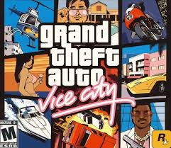
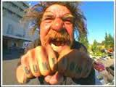
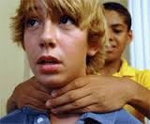
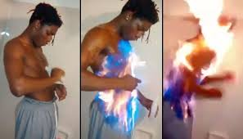
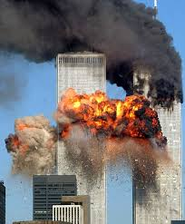
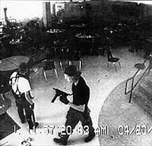
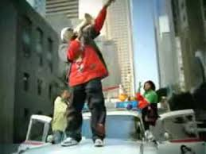
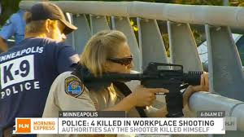
Examples of Media Copycats
Video Game Reenactments
The “Choking Game”
Fire Tricks
Bum Fights
Fire-in-the-Hole
Ghost Riding the Whip
School Shootings
Terrorism
Kidnappings
Workplace Violence
Notes:
The examples of new media copycats in modern society abound. New media allows for on-demand access to a variety of content at any time, from any location, on any digital device. Further, the interactive feedback, creative participation, and the formation of communities around media content have made new media a 20th century staple for the socialization process. According to Surette (2011), “new media are speculated to have criminogenic effects by providing avatar-like criminal models to copy.” (4) It is thought that criminal scripts may be picked up by those exposed to criminogenic media content during fantasy role-playing. This combined with the need in modern society to be special and admired by many has led to an increase in the influential impact of the media. New media also has the potential to lead to crime through communications that are interpersonal in nature and encourage unlawful acts from geographic distances. Users of new media are able to find role models who think as they do and who will interact with them, all while maintaining their anonymity. This leads to a greater potential for the media to lead to copycats as may be seen in a number of the following examples.

Slide 9
A Reanalysis of Surette’s New Media and Offenders Report
Based on the report New Media and Copycat Crime Among Offenders: An Initial Look and Recommendations for Future Research (2011)
Looked at the correlation between new media, past copycat crime behaviors, and future copycat crime among male and female inmates
Measures
Assessment of past copycat behaviors
Respondent’s characterization of their future likelihood to commit a copycat crime given a risk-free scenario
Used multivariate analysis

Slide 10
Surette’s Major Findings
Provision of another estimate of the prevalence of crime among offenders
More common for male than for female offenders
Age was the only demographic factor to significantly predict both past a future copycat likelihood
The media consumption of offenders is not unique from non-offenders
All personality and attitude characteristics were considered important
Primary question left unanswered: the causal order of new media
Notes:
Age was the only demographic factor to significantly predict both past a future copycat likelihood …Younger offenders more likely to copycat.

Slide 11
Path Analysis
Structural Equation Modeling (SEM)
Dependent variable/Endogenous latent construct: Copycat Crime
Demographics
Personality characteristics
Copycat crime characteristics
Independent variable/Exogenous latent construct: New Media
Amount of new media exposure
Preferred new media content
Self-reported influence
Notes:
Dependent variable/Endogenous latent construct: Copycat Crime…
Demographics …indicated by age, race, and gender.
Personality characteristics …indicated by copycat crime propensity, criminal innovativeness, whether the respondent was seeking fame, whether the respondent was seeking thrills, and whether the respondent followed rules.
Copycat crime characteristics …whether their crime was committed alone or in a group, whether the crime involved planning, the type of crime committed, the idea source for the copycat crime, the age at which the respondent attempted a copycat crime, whether the respondent received punishment for their crime, whether the respondent thought about a copycat crime, and if the respondent tried a copycat crime.
Independent variable/Exogenous latent construct: New Media…
Amount of new media exposure…as indicated by the free time a respondent spends playing video games, the amount of free time a respondent spends on the Internet, the number of hours per day that a respondent spends on the Internet, and the number of hours per day that a respondent spends playing video games, no video games, and no Internet.
Preferred new media content…as indicated by the respondent’s favorite video game, the respondent’s favorite website, the respondent’s interest in crime media, and whether or not the media assisted the respondent with their crime.
Self-reported influence…as indicated by whether or not the respondent admired the media, how sure the respondent was that they were self-influenced by video games, whether video games had other influence, whether the Internet has other influence, and whether YouTube has other influence.

Slide 12
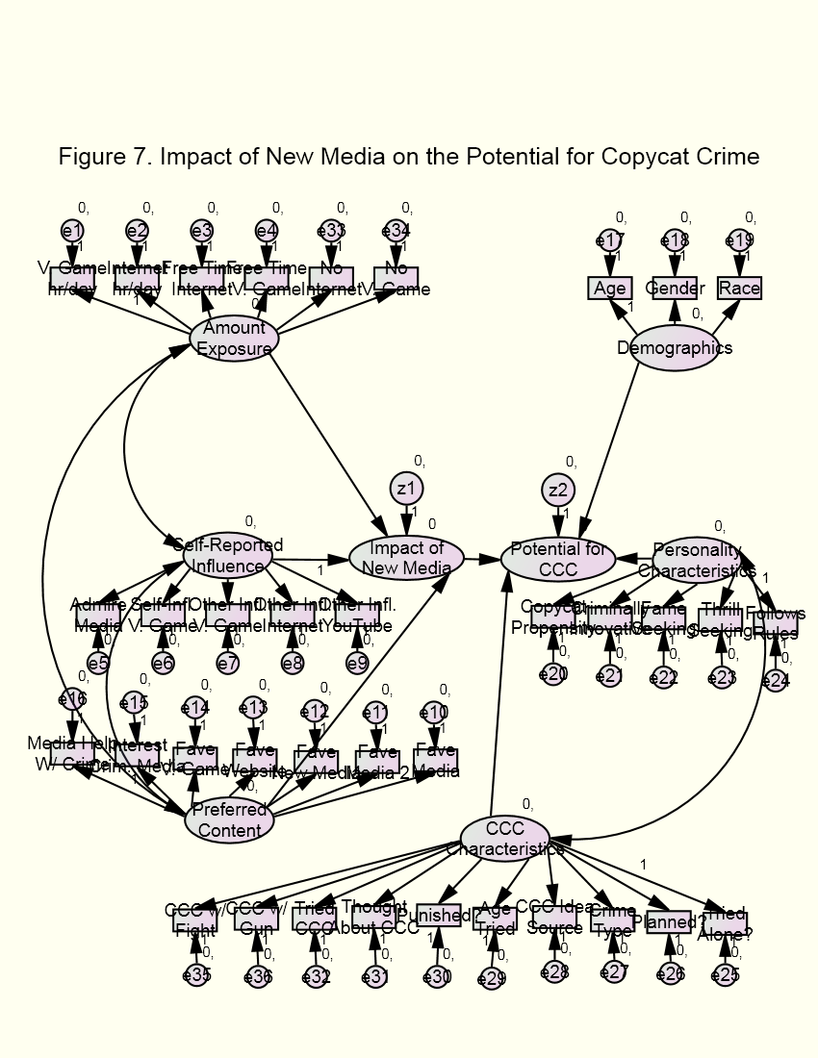
Notes:
Initial measurement model. The chi-square value for this model was 213.1 and the root mean square error of approximation (RMSEA) is 0.429 indicating that this model is not statistically significant at the 0.05 level.

Slide 13
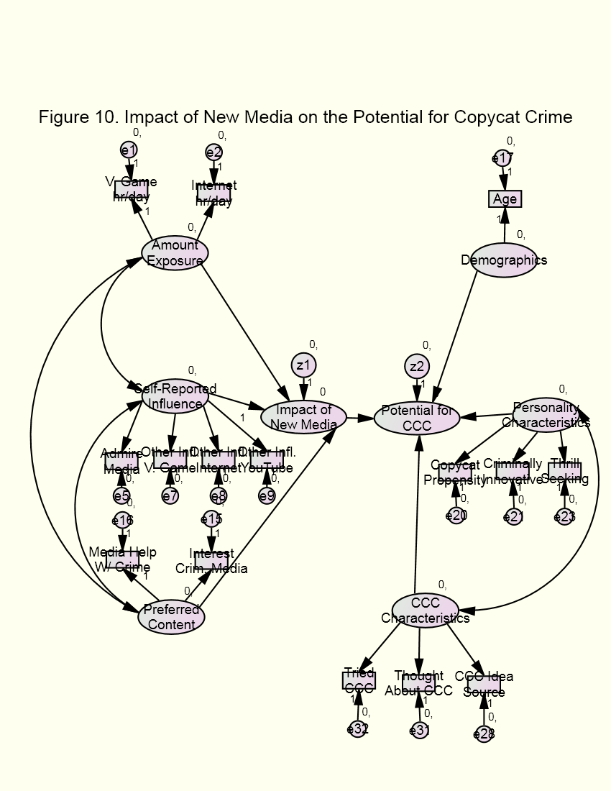
Notes:
Final measurement model.

Slide 14
New Media Copycat Crime Typology
 | High Profile | Low Profile
Individual Level | Kidnappings | Bum Fights
Aggregate Level | School Shootings | Video Game Reenactments
Societal Level | Terrorism | Workplace Violence
Notes:
The first dimension is based on the number of people impacted by the copycat crime.
The second dimension of the typology involves the motivations of the copycat criminal, whether the crimes are high profile or low profile.

Slide 15
Conclusions
New media has the potential to lead to copycat crime through many of the same processes as traditional media
However, due to its on-demand access, interactive user feedback, and extensive content, new media has even greater potential than traditional media to influence potential copycats
Many of the findings of previous research that examines copycat crime and the media are also expected to hold true for new media as well, just in a different manner
Characteristics of generator crimes and criminogenic models
The nature of subsequent media coverage
The social context
The characteristics of the copycat criminal
Notes:
The finding that age is an important demographic factor is supportive of Surette’s (2011) research. The finding that copycat propensity (being part of a preexisting criminal population for example), being criminally innovative, and seeking thrills are also important predictors of possible copycat criminals and crime have also found support in research on copycat offender correlations research. Finally, knowing where a copycat idea came from, having an offender who had previously thought about committing a copycat crime and having a copycat criminal who had attempted a copycat crime were also found to be important indicators, and their importance is supported by previous research.
Further, the exogenous latent variable, the impact of new media, was also examined in terms of new media exposure (video game hours per day and Internet hours per day), self-reported influence from new media (other influence from video games, other influence from the Internet, other influence from YouTube, and admiration of the media), and preferred new media content (interest in criminogenic media and media help with crime). The amount of time that is spent interacting with new media has been found in previous research to be important indicators of potential copycat crime (those who have more exposure are thought to be more likely to copy), and this study confirms these findings. This exploratory study also found that other influence from new media, whether that be video games, the Internet, or YouTube, along with admiration of the media is more likely to have the potential to lead to copycats. The fact that there is admitted influence and admiration make it more likely that a new media user will copy the models that they observe through these interactions. Finally, the fact that interest in criminogenic media and feeling as though the media is helpful in crime commission have also found support in previous research as those who are more likely to copycat are thought to have a propensity for criminogenic media.
The measurement models were then combined to form a proposed path model. It is suggested for future research that, since the analysis performed in this study was exploratory in nature, that a confirmatory study be conducted in an effort to verify the final proposed path model and the relationships suggested by the model.
New media has the potential to lead to copycat crime through many of the same processes as traditional media. However, due to its on-demand access, interactive user feedback, and extensive content, new media has even greater potential than traditional media to influence potential copycats. It is also expected that many of the same findings of previous research that examined copycat crime and the media are expected to hold true for new media as well, just in a different and often more impactful manner. These include the characteristics and nature of crime generators and criminogenic models, the nature of subsequent media coverage, social contexts, and the characteristics of the copycat criminal. Future research should look further into this relationships as well as examining the causal order of new media. This research should focus on information about the characteristics of generator crimes and what leads to those crimes being generators. Further research should also examine the demographics of copycat crime, the demographics of copycat criminals, the characteristics of the copycat crime, characteristics of new media based on the media type, and the scope of the new media and its potential reach with regards to copycat crime.

Slide 16
Suggestions for Future Research
Examine the causal order of new media
Examine generator crime information, the demographics of copycat criminals, the characteristics of the copycat crime, characteristics of new media based on the media type, and the scope of the new media and its potential reach with regards to copycat crime

